Slide 1
NFSv4.1/pNFS
Commercial & Open Solutions
“Ready for Prime Time Deployment”
February 13
FAST 2013
NFSv4.1 and pNFS product community

Slide 2
Value of NFSv4.1 / pNFS
Industry Standard
Secure
Performance and Scale
  Throughput
  Increased Storage Capacity (pNFS)
Manageable
  Separates namespace (metadata) from data
  Allows for data movement, tiering, manipulation while providing direct access to the client
2
Notes:
2

Slide 3
pNFS Vendors Status
EMC
NetApp
Panasas
Tonian
IBM
Microsoft
RedHat
Linux Client
Linux Server
Ganesha
Open-pNFS.org
SNIA

Slide 4
Linux Client
Linux has the first commercial implementation of NFSv4.1 client
Client implementation of NFSv4.1 and pNFS
  Supports all 3 pNFS layouts
  Emphasis on scalability and feature stability
    More performance optimisations to come
    O_DIRECT over pNFS available

Slide 5
Linux Client
Client supported in 2 distributions:
  Fedora 16/17/18beta has support for all 3 pNFS layout types (files, objects, blocks)
  Red Hat Enterprise Linux 6.2 & 6.3 has support for the files pNFS client
  On track to make pNFS a GA feature with RHEL6.4
    As part of GA, direct I/O support; big plus for database vendors.

Slide 6
Linux Server
Linux pNFS project is actively maintained by Tonian.
  Development tree: git://linux-nfs.org/projects/bhalevy/linux-pnfs.git
  http://wiki.linux-nfs.org/wiki/index.php/PNFS_Development
The project includes the reference implementation of the pnfs server for:
  files: Exporting GFS2 and OCFS2 (DLM based clustered file system)
    supporting parallel I/O for read access
  objects: Exporting the EXOFS file system.
Development appears to be accelerating now that the client is done
Server code to be submitted to the kernel in the coming months

Slide 7
RHEL 6.2/6.3 - pNFS
Client support only
pNFS file layout
Insert module into kernel
  Create /etc/modprobe.d/dist-nfs41.conf
  Add ‘alias nfs-layouttype4-1 nfs_layout_nfsv41_files‘
  Reboot
  With RHEL6.3 above will not be needed
Mount the file system with “minorversion” mount option
  E.g. mount –o minorversion=1 server:/export /mnt

Slide 8
SLES 11 SP2 - pNFS
Client support only
GA early 2013

Slide 9

EMC pNFS Block Server Status
Support for pNFS block server since 2010 – first GA product
Next EMC VNX release will include pNFS server optimized for performance
pNFS block server performance (from multiple clients with iSCSI) – 900MB/sec

Slide 10
EMC pNFS Block Client Status
EMC support Linux pNFS block client
New pNFS block client patches by EMC developers provide optimizations for performance in Linux Kernel 3.2
pNFS block client performance over iSCSI – read-100MB/sec; write-90MB/sec

Slide 11

NetApp NFS Support Matrix
Available: ONTAP 8.1
 | 7.3.x | 8.1 7-mode | 8.1 C-Mode
NFS v3 | Yes | Yes | Yes
NFS v4.0 | Yes | Yes | Yes
NFS v4.0 with Delegations | Yes | Yes | Yes
NFS v4.0 with Referrals | No | No | Yes
NFS v4.1 | No | No | Yes
NFS v4.1 with pNFS | No | No | Yes
NFS v4.1 with Referrals | No | No | Yes
NFS v4.1 with Delegations | No | No | No
NFS v4.1 with pNFS and Delegations | No | No | No

Slide 12




Cluster-Mode – Optimized Data Path with pNFS
3
4
Meta-data Path
1
N-Blade
NFS, Network, M-Host
Conversion to SpinNP
VLDB/Name Lookup
N-Blade
NFS, Network, M-Host
Conversion to SpinNP
VLDB/Name Lookup
Data Path
SpinNP
5
2
Memory Bus
Gigabit Cluster
interconnect
Memory Bus
D-Blade
Network stack, WAFL, Caching
Meta-data,data, Locking
D-Blade
Network Stack, WAFL, Caching
Meta-data,data, Locking
3
Storage
Storage
Direct network path to volume
Layout invalidation trigger new network path computation
Automatic provisioning
Minimum cluster traffic between nodes
Faster response time

Slide 13

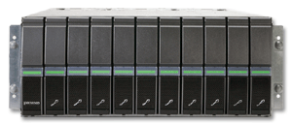
Panasas to ship pNFS in 2013
Panasas a founding advocate of pNFS standards process, has contributed to Linux client & server code, especially object layout code
Panasas systems designed from the ground up, anticipating pNFS
  True scale-out architecture backed by high-performance PanFS file system
  Today shipping with DirectFlow, precursor to pNFS with 8 years of production use
  pNFS Objects will be ideal for high throughput applications
Linux Compute Nodes
Panasas
Director Blades
pNFS Client
DirectFlow Client
NFSv4.1
pNFSd Server
DirectFlow Client
Panasas
RPCs
read/write
iSCSI/OSD
Panasas Metadata Server
Panasas ActiveStor
metadata
iSCSI/OSD

Slide 14
Panasas pNFS Scaling
Panasas has already demonstrated pNFS scaling to 128 clients at multiple gigabytes per second

Slide 15

IBM GPFS
File-based pNFS Clients
GPFS Servers
Linux, AIX, Windows
Storage
AIX
Windows
Linux
Fully-symmetric GPFS architecture - scalable data and metadata
  pNFS client can mount and retrieve layout from any GPFS node
  Metadata requests load balanced across cluster
  Direct data access from any GPFS server
  Flexible layout creation
Future integration with AFM (Panache) and FPO (SNC)
Active development of user-space NFS server (Ganesha)
Joined Open-pNFS

Slide 16
Windows Server 2012
Base NFSv4.1 only
  Mandatory aspects of RFC 5661
Integrated with Windows Failover clustering
Identity Mapping Support
  Passwd/group file mapping
  Active Directory
  ADLDS or 3rd party LDAP stores (RFC 2307 compliant)
  User name mapping (legacy)
RPCSEC_GSS support
  Krb5, Krb5i, and Krb5p
Multiprotocol access (SMB / NFS) to same share
Volume Mount Point Support

Slide 17
Tonian Status
Tonian founded in 2010
  Charles River Ventures and Cedar Fund
Tonian is developing a pNFS-based products for the enterprise market
pNFS Leadership
  Maintainer for kernel based pNFSd
  Facilitating open-pNFS.org
Contacts
  CTO: Benny Halevy bhalevy@tonian.com
  VP Products & Marketing: Doug O’Flaherty douglas@tonian.com

Slide 18
Tonian Update
Clustered enterprise workloads are common
  Virtualization, Cloud, Big Data
pNFS metadata virtualizes data location
  Transparent to the application
  With more flexibility
Focused on policy-based metadata services
  Single namespace flexibility
  Data mobility
  Dynamic storage allocation based upon application
Products to be announced in 1H 2013

Slide 19
Update on Layouts in IETF
Tonian extending file and object layout
  Flexible Files Layout (a.k.a NFS Objects layout)
  Adds per-file, flexible striping patterns over the NFSv4.1 files layout
  Supports mirroring and advanced RAID striping patterns
  Supports legacy NFS servers
  Standalone data servers can be clustered over pNFS
  Back-end control protocol is optional
    Can support existing clustered file systems, like GlusterFS or Ceph.
EMC has also submitted a proposal
  pNFS Lustre Layout
  Aims at replacing native Lustre clients with standard pNFS

Slide 20
NFS-Ganesha (1/2)
NFS-Ganesha is a user space implementation of a NFSv2/3/4.x including pNFS features (starting with FILES_LAYOUT4)
It works on several FS backends : XFS, ZFS, GPFS, LUSTRE, CEPH, HPSS (HSM from IBM Gov).
It has a generic VFS backend (based on 2.6.39 and later's « open by handle » feature)
It can be used as a NFSv4 proxy
It can be used with any FUSE ready product via « FUSELIKE backend »
It supports NFSv4.0 and NFSv4.1/pNFS

Slide 21
NFS-Ganesha (2/2)
The project started in early 2005 at CEA/DAM. It is used in production at CEA/DAM's compute centers
In 2009, IBM Joined the community
In 2010, Linux Box joined the community
In 2011 Panasas joined the community
The community is now quite active
Want to join ? You're welcome :-)
Useful links:
  http://nfs-ganesha.sf.net
  Http://github.com/phdeniel/nfs-ganesha.git
  nfs-ganesha-devel@lists.sourceforge.net

Slide 22
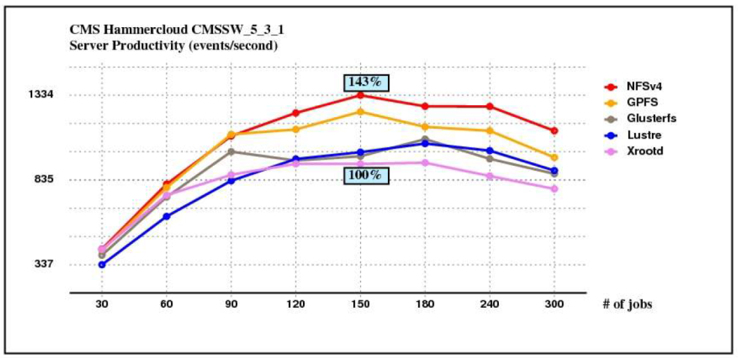
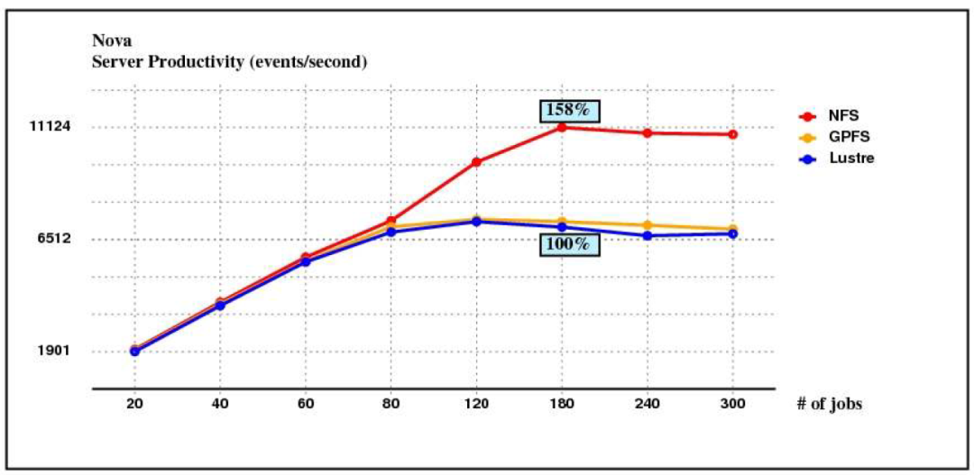
NFSv4 Performance
HEPiX Working Group report, October 2012 from CERN
https://indico.cern.ch/getFile.py/access?contribId=41&sessionId=3&resId=1&materialId=slides&confId=199025
Copyright Andrei Masslenikov, CERN CASPUR/CINECA

Slide 23
Getting Started with NFSv4.1/pNFS
Assist user community as NFSv4.1 is tested and deployed
Gather NFSv4.1 practical deployment information on a shared web site
E.g. Opensource toolset for evaluation

Slide 24












pNFS community of industry leaders that support the development and adoption of the pNFS standard
Focused on Use Cases & Applications
www.open-pnfs.org

Slide 25










SNIA ESF NFS SIG
The SNIA Ethernet Storage Forum (ESF) focuses on educating end-users about Ethernet-connected storage networking technologies
NFS SIG drives adoption and understanding of pNFS across vendors to constituents
  Marketing, industry adoption, Open Source updates
www.snia.org/forums/esf

Slide 26
Addenda
Windows NFSv4.1 Client for Windows
  http://www.citi.umich.edu/projects/nfsv4/windows/
Fedora16/17/18beta
  http://fedoraproject.org/get-fedora
Linux pNFS Server
  http://wiki.linux-nfs.org/wiki/index.php/PNFS_Development
Contacts
  Steve Dickson steved@redhat.com
  Alex McDonald alexmc@netapp.com
  Douglas O'Flaherty douglas@tonian.com

