Slide 1
Vis-à-vis Cryptography : Private and Trustworthy In-Person Certifications
Ian Miers*, Matthew Green*
Christoph U. LEHMANN†, AVIEL D. RUBIN*
*Johns Hopkins University Department of Computer Science
†Johns Hopkins University School of Medicine
Notes:
Meta problem, most talks involves computers authenticating themselves to each other . This deals with people authenticating to each other face to face

Slide 2
A compelling case for privacy and security
STIs raise serious privacy concerns
  Something people actual use technology for now
  Something people will not share on Facebook
Strong incentives exist to cheat.
  Fake a negative test to get sex
  Fake a positive test to get revenge

Slide 3
STI Notification
Traditionally done
  In person, by phone, or mail
  By a public health investigator
Impractical because of
  Number of chlamydia and gonorrhea cases
  Reporting honesty
  Anonymous encounters arranged online

Slide 4
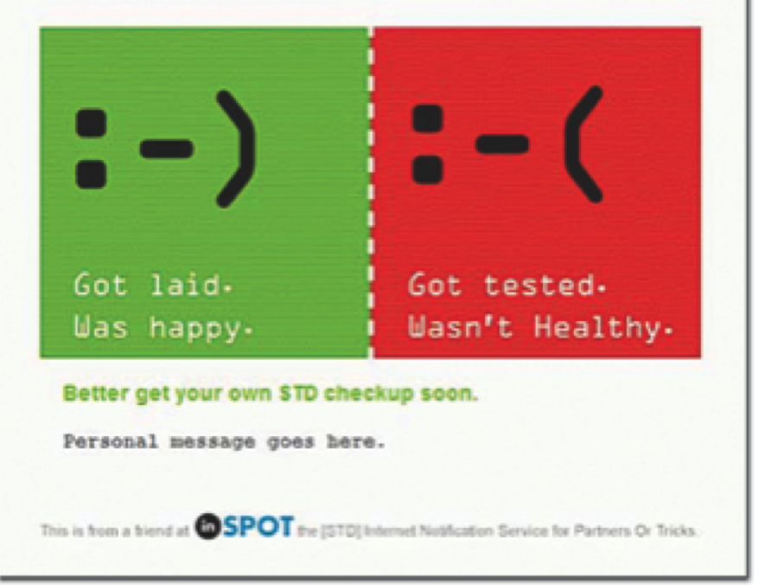
inSPOT
30k notifications
sent between 2004 and 2008
The First Online STD Partner Notification System Using Electronic Postcards

Slide 5
inSPOT Issues
Privacy
  Sensitive information
    Sexual Orientation
    Sexual Partners
    STI Status
  Disclosure risks
    inSPOT’s server compromise
    Mail provider / account compromise
    Targeted Advertising
Security
  Play a joke on a friend
  Harass former sexual partner

Slide 6
STI Certification
Trust me
  Ask them
  Check profile on some dating site
Somewhat verified
  qpid.me
  Bring test results with you

Slide 7
TruSTI
A protocol for STI status certification and exposure notification using mobile devices

Slide 12
Security Goals
Unforgeability
  Alice cannot convince Bob she has a positive or negative STI unless she has such a result from the clinic
Deniability
  No one can convince a third party of someone’s STI result or even that the interaction took place
Reciprocal anonymity
  Running these protocols should decrease Alice or Bob’s anonymity no more than the an in person meeting

Slide 13
Standard Approaches Fail
Digital Certificate
  Not anonymous
  not deniable
Physical ID Card
  Counterfeitable
  Revocation is logistically problematic

Slide 14
Anonymous Credentials FAIL
  Present third party signed messages anonymously
  Impose a tax on transfer via:
    All or nothing “non-transferability”
    PKI assured non-transferability
  Real non-transferability implies cryptographic proof an encounter took place
  Does not work for notification

Slide 15
OUR APPROACH
  Sign STI Status + Photo
  Use clinics and testing labs as trusted authorities
    Already exists and is trusted with sensitive data
    Already regulated by HIPAA
  Use a deniable construction for showing status and photo

Slide 16
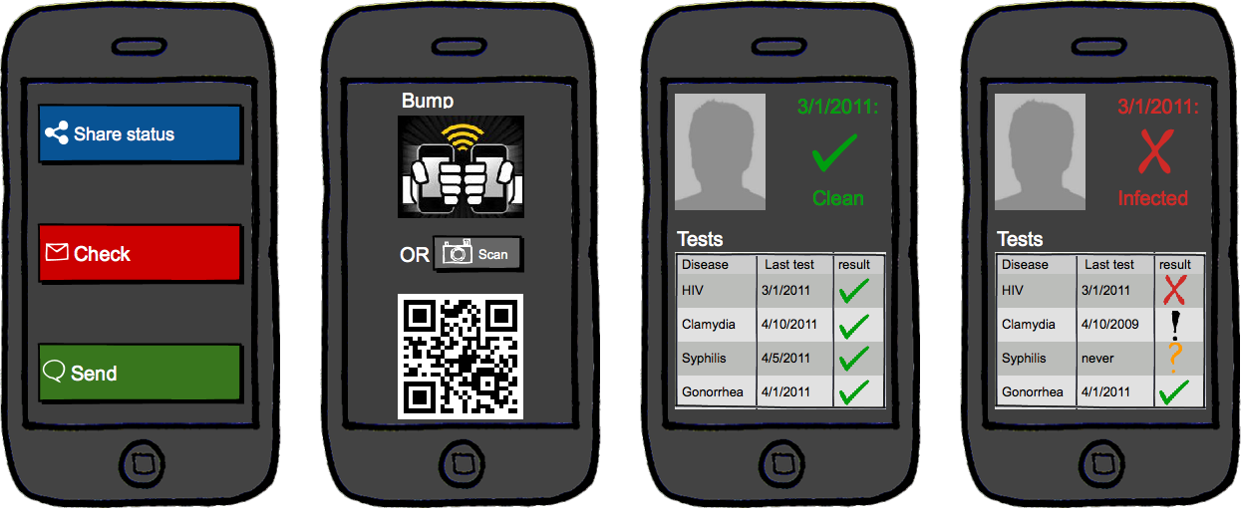
UI Mockup
Objects in this mockup may be prettier than they appear in the actual product

Slide 17

Cryptographic Background
One foot down the rabbit hole

Slide 18
Non interactive Zero Knowledge proofs
A proof of knowledge of values satisfying an equation that does not reveal those values:

Slide 19
Signatures with efficient protocols
Standard digital signature scheme with one additional feature:
Users can prove they have a signed message without revealing the signature

Slide 20

Commitments
Allow you to commit and later reveal a value
Csetup: generates parameters
Commit: commits to a value
Decommit: reveal the value

Slide 21
The technique
Alice wants to prove to Bob she has a negative STI test. They both have the app and are enrolled in the system
Alice gives Bob a NIZKPoK that either
  She knows a number Bob committed to
  OR
  She has a signature on her STI status and photo from the clinic.

Slide 22
Certify protocol
Bob Commits to a nonce n
Alice commits to π
Bob reveals n
Alice reveals
π

Slide 23
PROGRESS/ Future Work
Complete Application
Mark users as exposed
Propagating notifications
Compute exposure risk for users

Slide 24
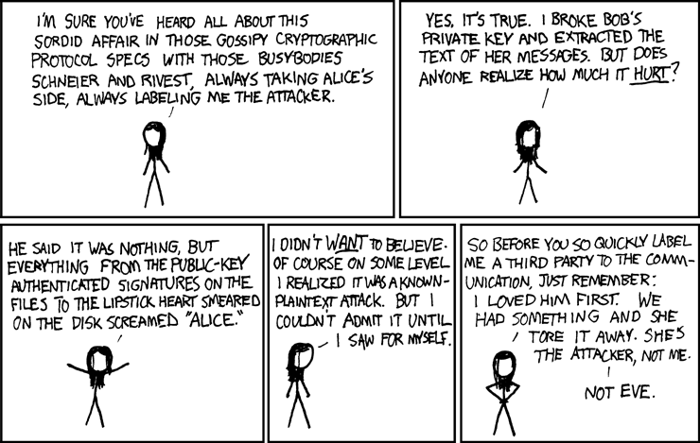
Questions?
Alt-text:Yet one more reason I'm barred from speaking at crypto conferences
Randal Monroe xkcd.com/177

