Slide 1
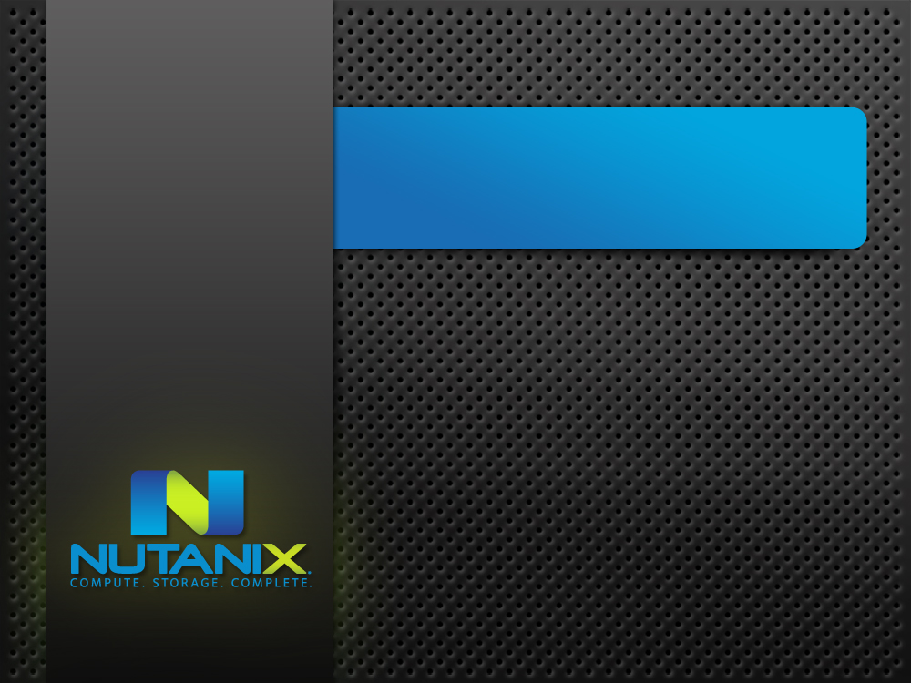
Nutanix: bringing compute and storage together
Mohit Aron, Co-founder & CTO

Slide 2
Famous quote from 1990s
“It is faster to fetch data from across the network than locally”

Slide 3
Change in hardware trends
A single SSD can deliver more than 10 Gbps
Simple RAID configurations can deliver phenomenal bandwidths
End result: network speeds now lag behind disk speeds
  Either use non-commodity expensive networking
  Or migrate storage closer to applications

Slide 4
The Nutanix solution
Appliance consisting of cluster of high-end commodity nodes
  Distributed, incrementally scalable
Storage lives inside the same nodes that run applications
  No need for centralized storage (SAN or NAS)
Virtualization provides separation
  Applications and storage software run inside VMs

Slide 5
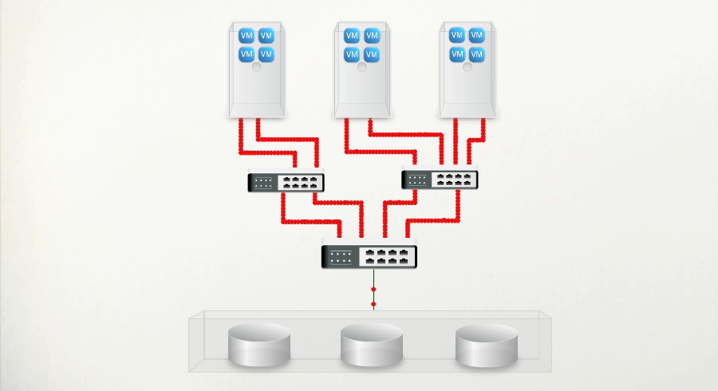
Triggering Consolidation 2.0
Converging Application Servers and Storage Servers
Nutanix Virtualization Appliance
The New Virtualized Datacenter Building Block
It’s not storage rather a virtualization appliance
Think server-attached FusionIO+Seagate storage delivering a true NetApp experience for local VMs
Notes:
Enterprise-grade Data
Management
Fault-tolerance
Primary Deduplication
Automated Storage Tiering
Writeable Snapshots
Disaster Recovery
Backups…

